Slide 1
Predicting subacute motor recovery in tetraplegia by early assessment of lower motor neuron and subclinical voluntary motor unit action potentials
David Balser, MD

Slide 2
Disclosures
I have no financial conflicts of interest related to the information to be presented.
I will not discuss the off-label uses of medical devices or pharmaceuticals.

Slide 3
Acknowledgements
Greg Nemunaitis, MD (former SCIMS Director)
Mary Jo Roach, PhD (former SCIMS Co-Director)
Kimberly Anderson, PhD (current SCIMS Director)
James Wilson, DO (current SCIMS Co-Director)
MetroHealth SCI Fellows from 2016-2021

Slide 4
Introduction

Slide 5
Terms
Term | Definition
NLI | Neurological Level of Injury
MUAP | Motor Unit Action Potential
MMT | Manual Motor Testing
SMMT | Stimulated Manual Motor Testing
Notes:
Before we start, I want to go over a few acronyms I’ll use through the study as I don’t want you to get lost. NLI is the level of the spinal cord injury. MUAP represents the signal generated when an EMG needle picks up a muscle motor unit during volitional contraction. MMT is a standardized strength exam on a 0-5 scale. And SMMT, which you may not have heard of, is a strength exam while you’re providing an electrical current to the muscles you’re testing.

Slide 6
Terms
NLI: Neurological Level of Injury (as determined by the ISNCSCI Exam)
MUAP: Motor Unit Action Potential. The waveform detected on electromyography when a motor neuron activates its muscle fibers
MMT: Manual Motor Testing. Standardized volitional strength assessment of muscles predominantly innervated by a single myotome.
SMMT: Stimulated Manual Motor Testing. Volitional strength assessment of a muscle in the presence of peripheral electrical stimulation.
Notes:
Before we start, I want to go over a few acronyms I’ll use through the study as I don’t want you to get lost. NLI is the level of the spinal cord injury. MUAP represents the signal generated when an EMG needle picks up a neuron stimulating its muscles. MMT is a standardized strength exam on a 0-5 scale. And sMMT, which you may not have heard of, is a strength exam while you’re providing an electrical current to the muscles you’re testing.

Slide 7
Will I be able to _________?
Regaining 1 motor level below the NLI: 66-90%¹
Most functional recovery: 3 months
Functional recovery plateau: 9 months²
Regaining antigravity (3/5) strength from 0/5: 27% (in cervical SCI)³
Regaining antigravity strength from 1-2/5: 97% (in cervical SCI)⁴
How can we be both early and accurate at prognosing spinal cord injury?
Notes:
Prognosis is very important in the subacute phase of spinal cord injury. It helps transition the patient from reacting to their situation to planning and calibrates the goals of therapy. I’ve put a few evidence based facts on here that I generally tell my patients just to illustrate how dependent prognosis is on a good motor exam. Think about your experiences assessing people with spinal cord injury a few days after the injury. Think about all the things that affect the exam – cognitive status, pain, medications – how accurate is your physical exam, and thus your impression about prognosis, during this time when a lot of important future decisions should be started. Can we be better at predicting a person’s recovery after injury, and can we be earlier if we just do something different? Something extra?

Slide 8
Methods

Slide 9
General Study Design
Population | Acute Traumatic Tetraplegia Unit of observation: single myotome
Index Tests | MUAP binary SMMT binary or continuous
Comparator/Outcome | ΔMMT change in motor strength from T0 – T + 4 months
Timing | Time 0 (T0): within 1 week of IRF admission Endpoint: T0 + 4 months
Setting | Acute Inpatient Rehabilitation Facility
Notes:
This is the PICOTS table describing the study, but first I want you to look at the text in orange: within 1 week. We’re prognosing spinal cord injury outcomes pretty much as soon as the person come to inpatient rehab. This is generally standard practice but still fresh in the subacute phase where several factors can still get in the way of a good and accurate ASIA exam.
We are recruiting people with high level spinal cord injury. We’re testing whether or not there’s an initial EMG signal or whether peripheral stimulation increases strength testing initially, and we’re seeing how well that relates to standard strength improvement over the course of 4 months.

Slide 10
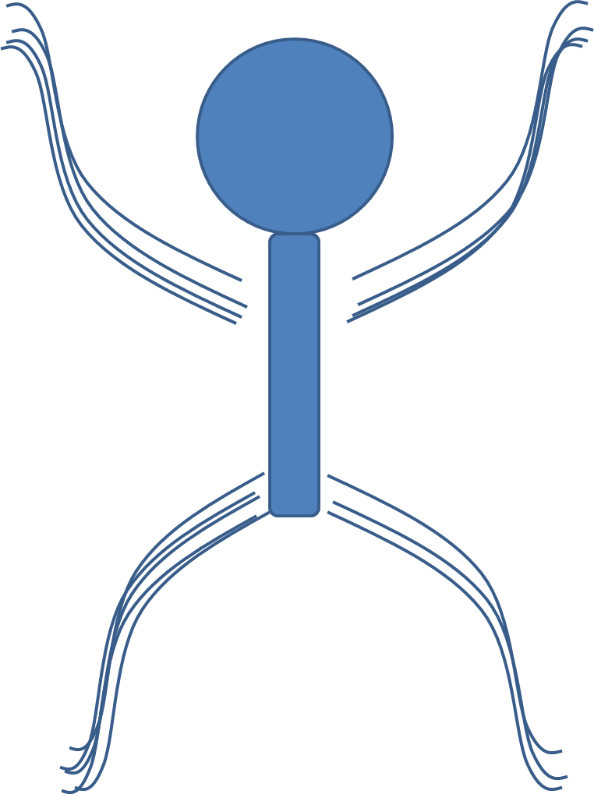
What did we do?
Participant enters Inpatient Rehabilitation Facility
MMT of Upper Extremities within 1 week
If MMT = 0, obtain MUAP
If MMT < 3, obtain SMMT
MMT of Upper Extremities at week 4
SMMT +
MUAP +
Notes:
Before I go over the text of the slide, I’d like to talk a bit about why we chose these tests. It’s because they reflect two distinct types of LMN injury in SCI. Positive stimulated manual motor testing suggests preserved peripheral nerves in an upper motor neuron injury. Present Motor Unit Action Potentials reveals at least a partially preserved upper and lower motor neuron pathway even in cases where damage is so severe the signal is clinically undetectable by physical exam. Undetectable by physical exam. So stands to reason that if you can already move your muscle against gravity, these tests might be redundant. We are choosing to do each test according to a selective protocol rather than performing all tests all the time.

Slide 11

Statistical Plan
Quantify Missing Data
Assess assumptions
Single factor analysis
MUAP study
SMMT study
ROC Analysis
MUAP + SMMT -> ΔMMT model
MUAP only -> ΔMMT model
SMMT -> ΔMMT model
Notes:
In terms of analysis, this is both a feasibility trial and test of the effectiveness of our hybrid approach. I’m going to talk about how successful we were in applying protocol to give you an idea of how hard this method might be to adapt consistently. We will then analyze each test independently to see their individual strength of correlation. Then, we will finish with a receiver operating characteristics curve to determine the quality of both the individual and combined tests to predict motor improvement.

Slide 12
Results

Slide 13
Recruitment and Analysis Flowchart
Screen 500 Muscles
Missing MMT1 or MMT4 133
MUAP Screen + 170
SMMT Screen + 222
MUAP Results 130 muscles
SMMT Results 201 muscles
Missing MUAP 40
Missing SMMT 21
MMT Screen Fail (too strong) MUAP: 197 SMMT: 145
Notes:
Here’s the study flowchart. We screened 50 people, 10 muscles per person, so 500 muscles. About a fourth of muscles didn’t have the initial MMT tests (at admission or discharge), and another third of the muscles were excluded from each test because of the protocol I told you about. So out of 500, we ended up with 170 EMG tests and 222 stimulated motor tests. Of those, we lost about a fourth of the EMG tests and 10% of the stimulated tests for various reasons. (refused, unavailable, sick, technically impossible, etc).

Slide 14
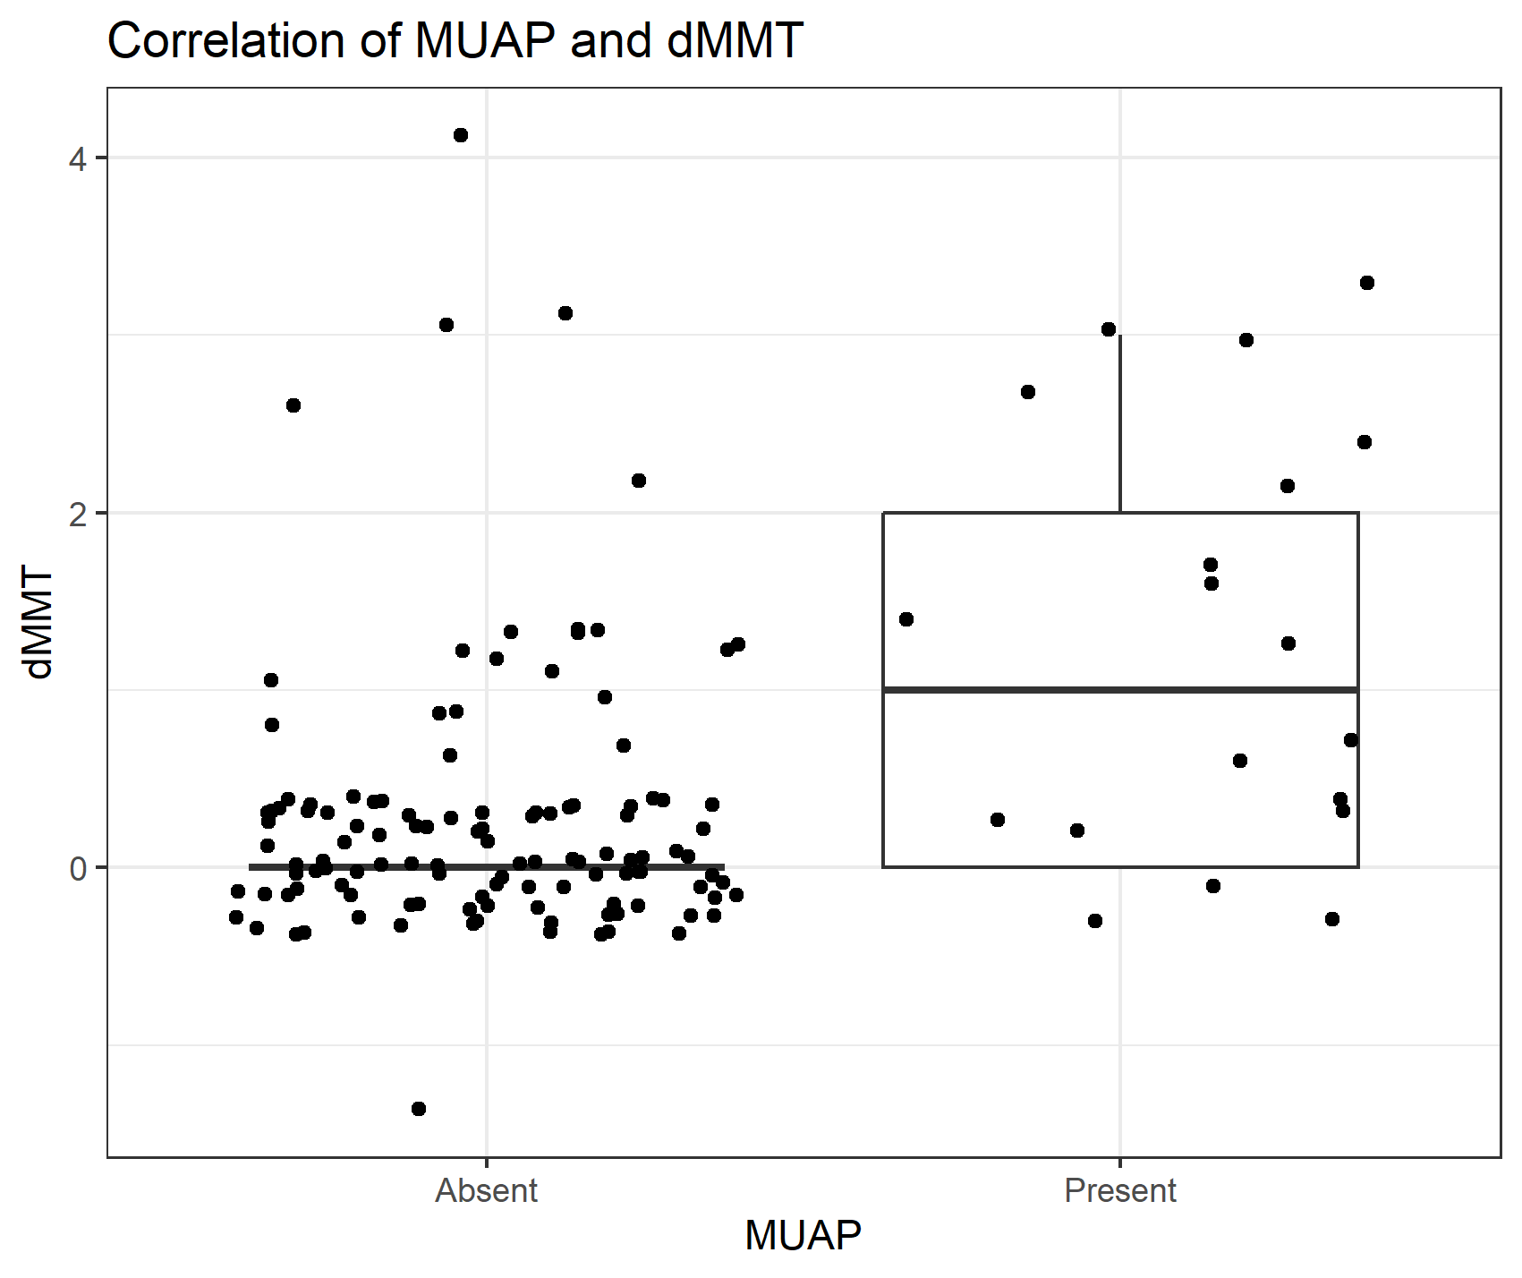
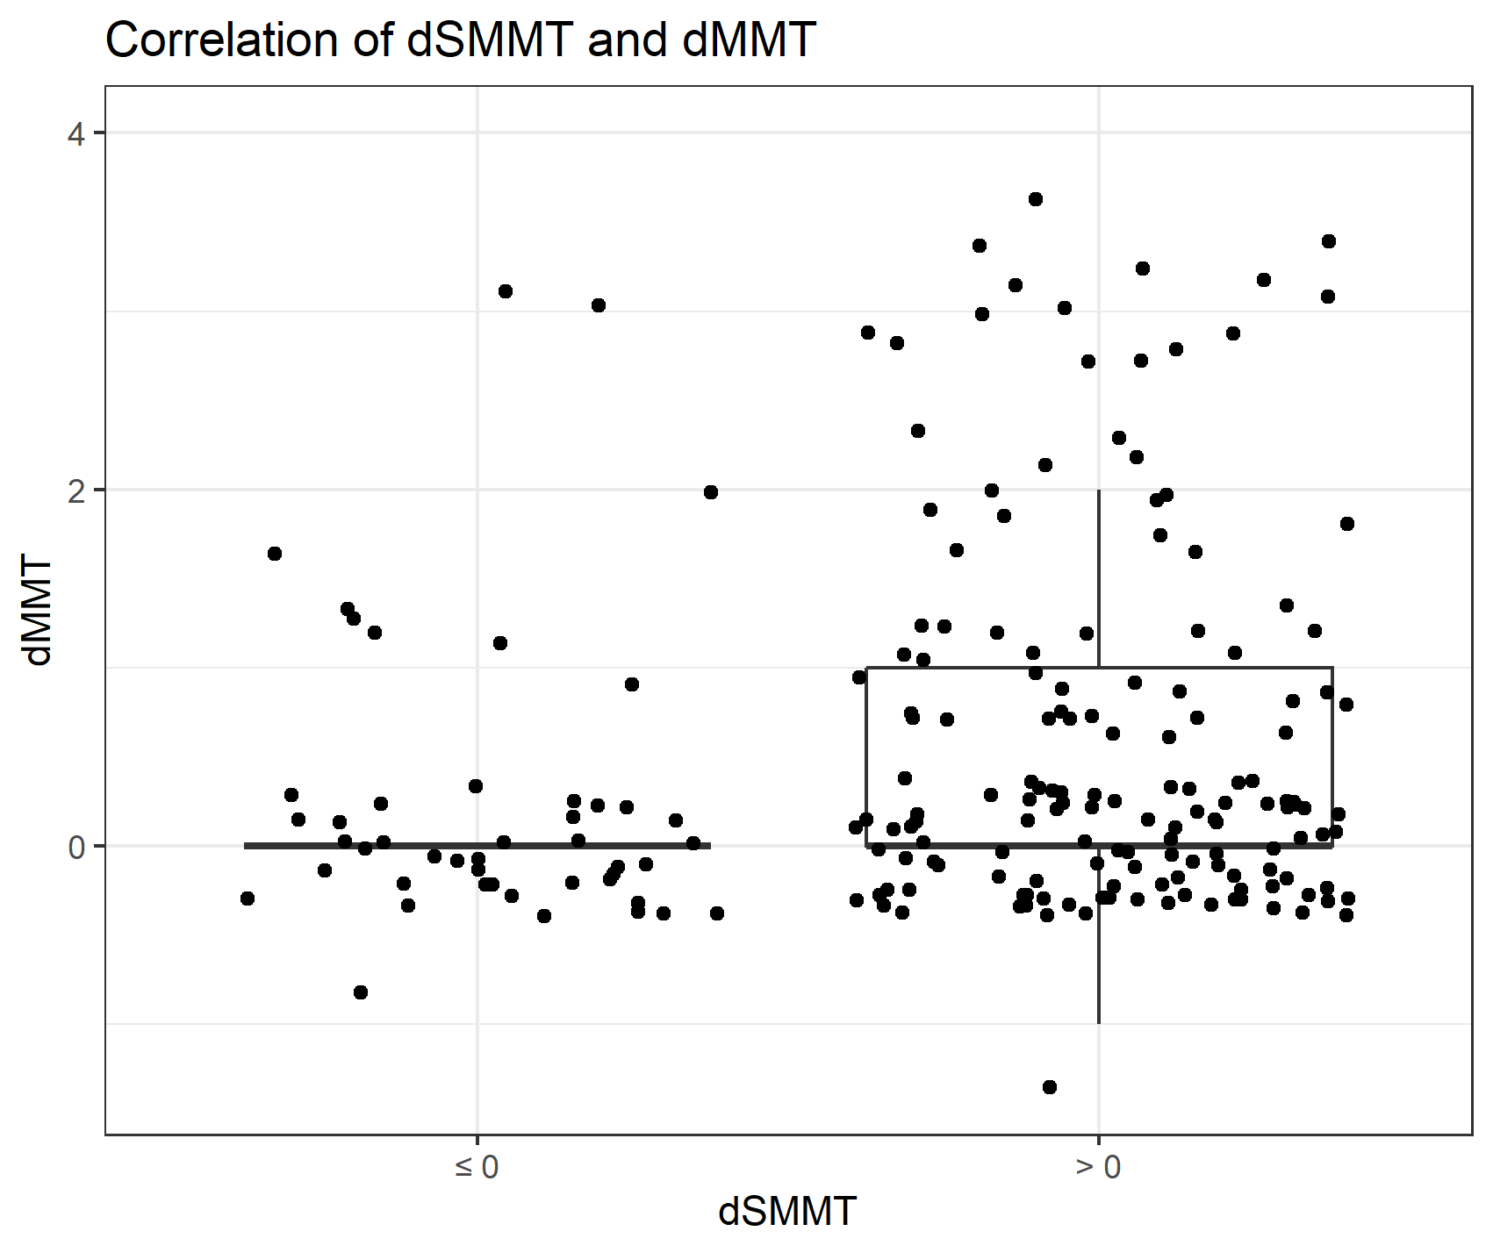
Distribution and Correlation
Spearman’s r = 0.39 (p < 0.001)
Kruskal-Wallis χ² = 5.8553 (p=0.0155)
Notes:
Here are the correlations of the individual tests with motor improvement. The X axis is binary – either we saw a motor unit action potential, or we didn’t. Either muscle strength improved with stimulated motor testing or it didn’t. The Y axis is the change in standard muscle strength over 4 weeks for each group. The scatterplot part of the graph might look a little confusing because I spread out data points on the X and Y axis to avoid overplotting, but I just wanted to give you a sense of where the data is most clustered. You see that most improvements with positive tests are clustered in the 0-1 range, but there are several muscles showing more improvement, with statistical significance to back that up.

Slide 15
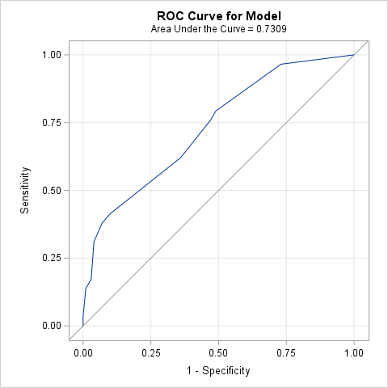
ROC: Combined SMMT and MUAP model
Predictors:
Were MUAPs Present at week 1?
How much did stimulation improve MMT at week 1 (SMMT)?
Model:
Outcome: Chance to improve MMT by week 4
Predictors: MUAP + SMMT
ROC Curve: Max Threshold = Max Youden Index
AUC = 0.73
Sensitivity: 41.4%
Specificity: 90%
Youden Index: 0.31
Notes:
Here’s the ROC curve of an algorithm that asks whether a motor unit action potential is present and how much stimulation increased motor strength initially, then predicts whether muscle strength would improve on its own in 4 weeks. The best version of the predictive model had good specificity but middling sensitivity. Youden index, by the way, is a measure of the quality of an ROC curve, with 1 being the best.

Slide 16
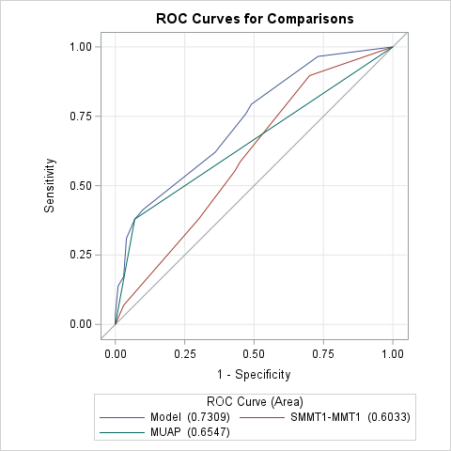
ROC: Component SMMT and MUAP Model
Would just using one predictor be better?
MUAP AUC: 0.65
SMMT AUC: 0.60
MUAP + SMMT AUC: 0.73
Answer: No
Notes:
We then compared the combined model with just using either the EMG test or the stimulated strength test independently. Both had receiver operating characteristics that were distinctly worse than the combined model. There’s a bit of loss of power because each test separately has fewer muscles under their belts than a model that uses both tests combined, but the data still strongly suggests that the tests supplement each other.

Slide 17
Discussion

Slide 18
Summary and ROC Curve
Results
ΔMMT during acute rehab were correlated with MUAP and SMMT
Sensitivity: 41.4% Specificity: 90%
Our Model: AUC 0.73 (but different predictors and outcome measure)
Hupp et al, 2018⁶
Population: 224 individuals with tetraplegia
Index Model: Age, Motor Score, SEP, MEP, NCS
Comparison Model: Age, Motor Score
Outcome: SCIM III
Index AUC: 0.956 (95% CI: 0.930–0.982)
Comparison AUC: 0.936 (95% CI: 0.904–0.968)
Notes:
In short, we found that the protocol of motor unit action potentials and stimulated manual motor testing at the beginning of rehab was correlated with improvement in simple motor strength 4 months out. Using the tests together is decent but not spectacular at predicting any improvement per muscle. Regarding the strength of the ROC curve, one other study had a similar strategy, but using a model of more elements like age, motor and sensory evoked potentials, and nerve conduction study results, with a different outcome measure – SCIM III. The more complex model (which incidentally, was incomplete in 87.1% of participants) had a great area under the curve but wasn’t much better than a model that just used age and motor score.

Slide 19
Feasibility
Missing Data = Missed MMT testing (wk 1 or 4) + Missed MUAP or SMMT
MUAP: Missing Data
Participants: 17/46 (40.0%)
Muscles: 173/303 (57.1%)
SMMT: Missing Data
Participants: 14/49 (28.6%)
Muscles: 154/355 (43.4%)
Huang et al, 2022⁵
5 SCI, 8 Controls
H-Reflex, Electrical Perceptual Threshold, TMS MEP
Outcome: Lower Extremity Motor Score at 6 months
Results: EPT correlated with LEMS, H-reflex didn’t
Incomplete MEP data: couldn’t get from 2/5 participants (40% missing)
Hupp et al, 2018⁶
224 SCI (out of 1742, 87.1% missing)

Slide 20
Feasibility
Source | Missing Data Rate | Caveats
Huang et al, 2022⁵ | MEP: 40% | Due to underestimating interruptions at bedside inpatient
Hupp et al, 2018⁶ | MEP, NCS: 87.1% | Due to exclusion of participants if any element was missing, amount of missing data for each test unclear
Our Study | MUAP: 40.0%, (12% where attempted) SMMT: 28.6%, (2.7% where attempted) | “Where attempted” means MMT was completed and appropriate for each test.
Notes:
Several researchers have attempted similar studies before, and I would just like to review a few to see how doable our project is in comparison. A raw comparison is actually not that helpful as previous studies mark participants as missing if any of that person’s muscles weren’t surveyed per protocol. We include muscle level data even if we missed a few muscles for each participant out of protocol, and we don’t even do each test on each muscle by design. Even so, I calculated that 40% of EMGs and 29% of stimulated strength tests were incomplete on a patient level basis compared to the standards of other studies, which is actually pretty good by comparison. If we only looked at the people we wanted to perform the new tests on per our algorithm, our per-person data completion is even better. Clearly, requiring testing only for certain motor strengths as part of an intentional protocol helped feasibility.

Slide 21
Limitations
Practical
Experimental / Statistical
Patient population - High complexity of longitudinal study for acute tetraplegia population
Test - EMG likely impractical clinical tool for routine used in acute tetraplegia
Setting – Mixed study design was detrimental (acute rehab and 4 weeks).
Exploratory – need another study to validate positivity cutoffs
Reference test and outcome should be separate
Confounders / Factors – participant, level of injury, nature of injury, motor level and laterality
Time – arbitrary 4-week period
Notes:
Ultimately, when you consider how to better prognose spinal cord injury earlier and more accurately, you have to contend with practicality. We originally intended to perform the tests during the acute hospitalization phase and follow participants for 2 years, but that was not feasible. Surprisingly, obtaining timely manual motor testing for the study was as much of a bottleneck as getting the additional tests, so making motor testing as part of model systems data collection more robust may be low-hanging fruit in reducing the missing data rate.

Slide 22
Conclusions
EMG and E-Stim have value in predicting subacute SCI motor recovery
Obtaining electrically stimulated volitional MMT may be easier than EMG assessments during Inpatient Rehab
Obtaining EMG MUAPs appears comparable to TMS MEP
Acute SCI prognostic models should include demographic and physical exam elements
One or more special testing elements including neuromodulation / electromyography may strengthen prediction
Notes:
In summary, there is value in performing EMG and stimulated muscle strength tests in select participants and select muscles where appropriate instead of trying to test every muscle in everybody. To preserve resources and feasibility without sacrificing validity, we need a sophisticated, standard protocol to apply each test judiciously, as the benefits of comprehensive electrodiagnostics are limited. There has to be a balance between pragmatism and power so we don’t miss data but also preserve the prognostic potential we know is there. I hope this study helps future researchers and clinicians hone in on that happy medium.

Slide 23
References
Alizadeh A, Dyck SM, Karimi-Abdolrezaee S. Traumatic Spinal Cord Injury: An Overview of Pathophysiology, Models and Acute Injury Mechanisms. Front Neurol. 2019 Mar 22;10:282.
Fehlings MG, Vaccaro AR, Boakye M. Essentials of spinal cord injury: basic research to clinical practice. Thieme; 2012.
Fawcett JW, Curt A, Steeves JD, Coleman WP, Tuszynski MH, Lammertse D, et al. Guidelines for the conduct of clinical trials for spinal cord injury as developed by the ICCP panel: spontaneous recovery after spinal cord injury and statistical power needed for therapeutic clinical trials. Spinal Cord. 2007 Mar;45(3):190–205.
Kirshblum SC, O’Connor KC. Predicting neurologic recovery in traumatic cervical spinal cord injury. Arch Phys Med Rehabil. 1998 Nov;79(11):1456–66.
Huang YN, Meftah EM, Pion CH, Mac-Thiong JM, Cohen-Adad J, Barthélemy D. Quantitative electrophysiological assessments as predictive markers of lower limb motor recovery after spinal cord injury: a pilot study with an adaptive trial design. Spinal Cord Ser Cases. 2022 Feb 24;8(1):26.
Hupp M, Pavese C, Bachmann LM, Koller R, Schubert M, EMSCI Study Group. Electrophysiological Multimodal Assessments Improve Outcome Prediction in Traumatic Cervical Spinal Cord Injury. J Neurotrauma. 2018 Dec 15;35(24):2916–23.

